Slide 1
Predicting the Existence of Dyslexia in Children Using fMRI
Presented by: Chen Cohen and Tom Beer
Supervised by: Yochai Blau
Clinical expert: Tzipi Horowitz-Kraus
Signal and Image Processing Lab
September 2016

Slide 2
Results so far

Slide 3
1 - LEM, no clustering
Using raw data after SPM pre-processing, including smoothing
Parameters we’ve checked:
Dimensions 10,15
Nearest neighbors 10:2:20
* All results were nearly the same.

Slide 4
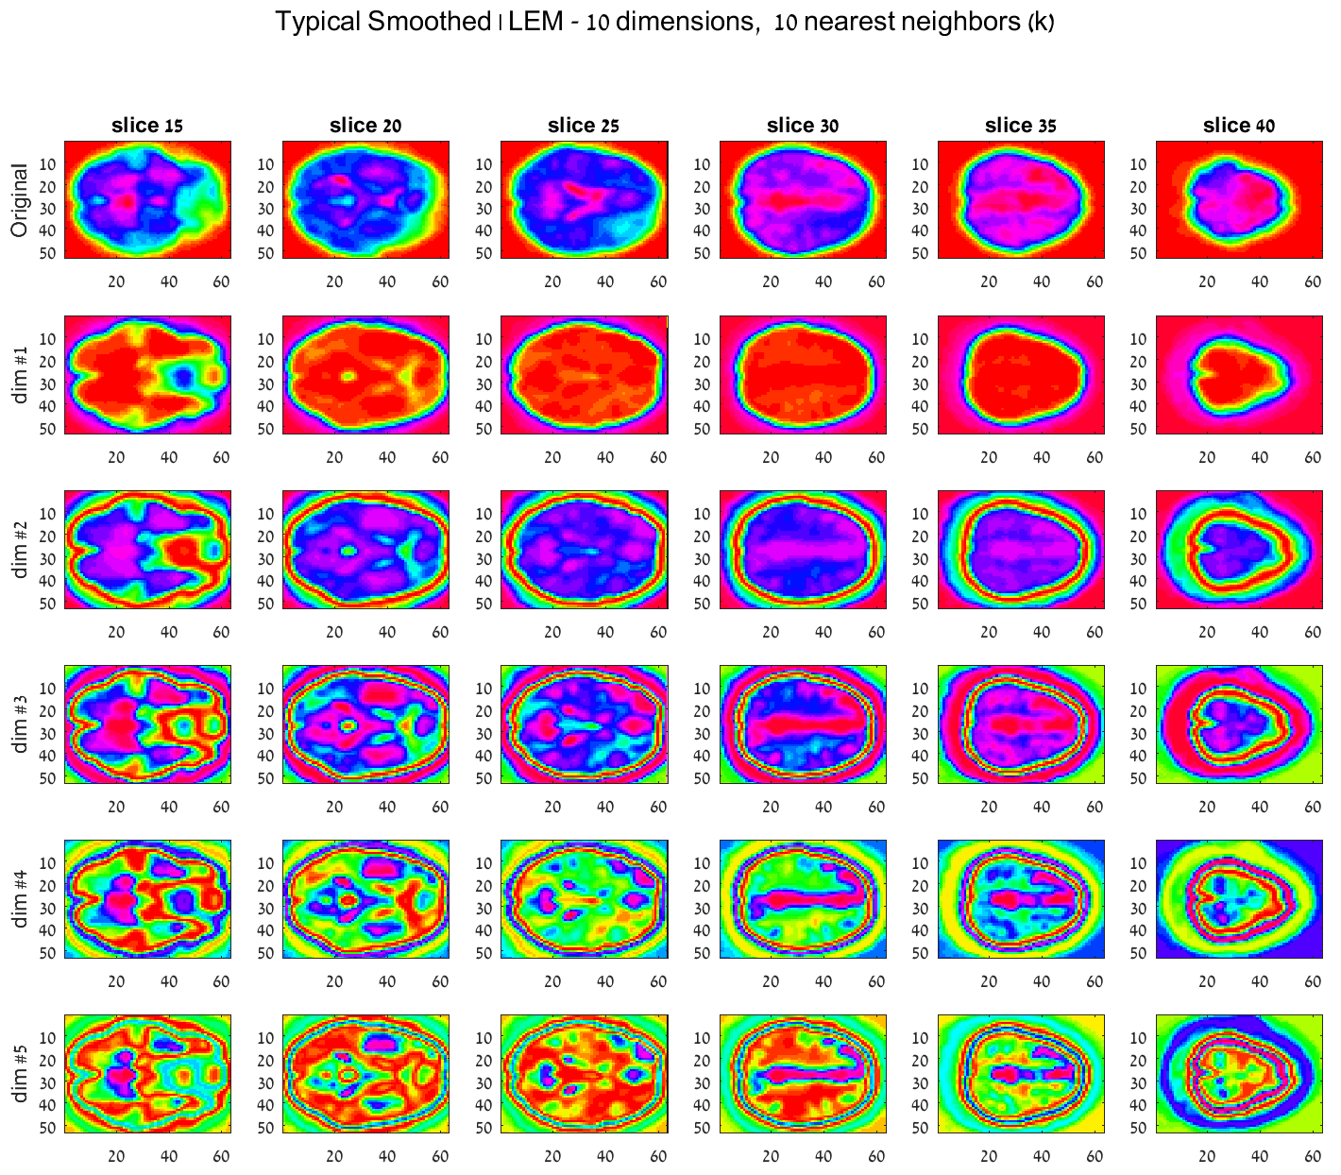
Dim #1
Dim #2
Dim #3
Dim #4
Dim #5
Notes:
View 3

Slide 5
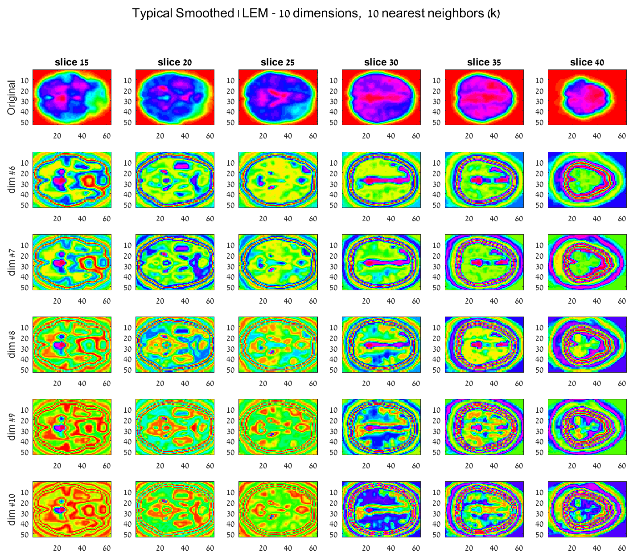
Dim #6
Dim #7
Dim #8
Dim #9
Dim #10

Slide 6
2 - LEM & Clustering
Using raw data after SPM pre-processing, including smoothing
LEM
Dimensions 10,15
Nearest neighbors 10:2:20
* All results were nearly the same.
K means
5, 7, 9, 10, 15, 20, 25 Clusters

Slide 7
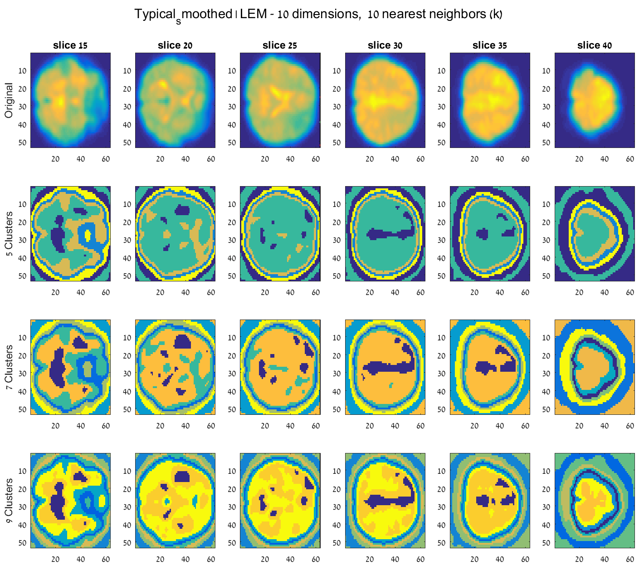
Notes:
View 1

Slide 8
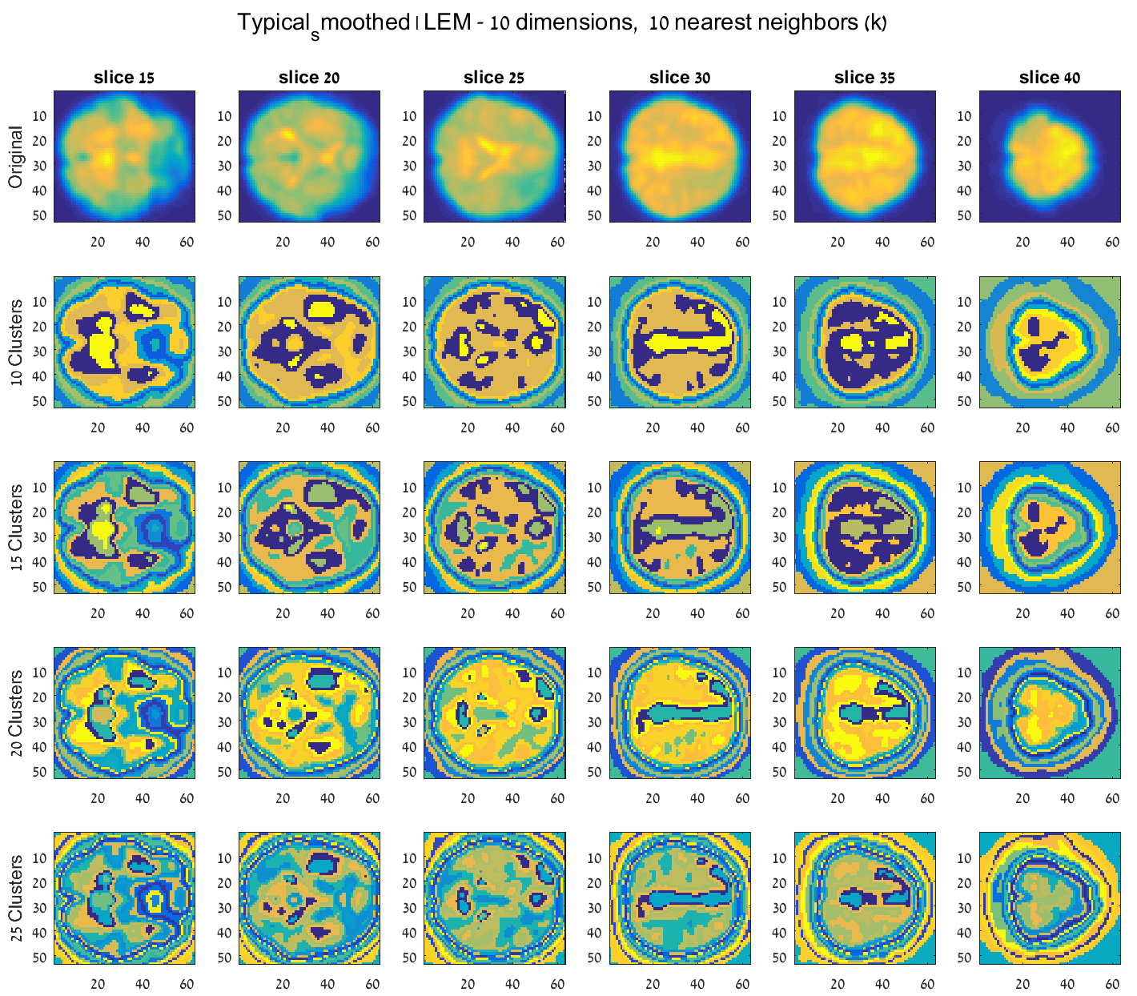

Slide 9
Additional Tested Approaches
Non-linear Algorithms:
LLE - locally linear embedding
DM - diffusion maps
HLLE - Hessian LLE
KPCA - kernel PCA
LTSA - local tangent space alignment
→ memory problems or never finished running
Data manipulations:
Band-pass temporal filtering – memory problems
Partial brain analysis (10\46 slices) – no improvement
Replacing the similarity metric from distance to correlation - WIP

Slide 10
Discussion
SVM
Input vectors
…

